Slide 1
MAIO
Rethinking Zero-Copy Networking
Markuze Alex
VMware
Notes:
Hi, all thank you for joining. Today I will be talking about project MAIO and zero-copy networking.
This is a moonshot talk so many things I will discuss are experimental and up to change.

Slide 2

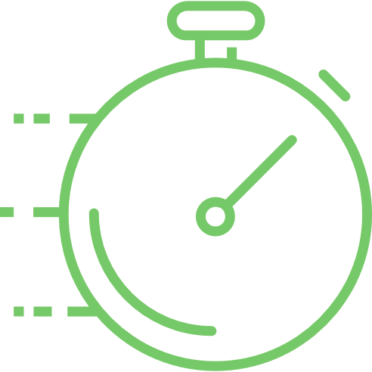


User-space Networking
For fast networks > 1 Gb/s
The Choice:
BSD Sockets
  Kernel Bypass
import socket /* Import */
s = socket.socket(socket.AF_INET,socket.SOCK_STREAM) /* Create */
s.connect((destination, port)) /* Connect - Routing */
s.sendall('Hello, world’) /* Send - TCP/IP */
Notes:
When building a network facing application there are essentially two choices. Either use ubiquitous sockets. (+) Which is as simple as importing a librarian and creating a socket, (+) connecting (+) and sending your I/O.
You get all the robust Kernel infrastructure of Routing, address resolution and transport protocols like TCP. And on the other hand (+) you can hire a team of engineers to maintain a volatile kernel bypass implementation(+).
And you make this choice because one is (+)fast and the other is slow.

Slide 3
Zero-Copy Network I/O
The Holy Grail
Why Zero-Copy?
  Performance
  Performance
  Performance
70% CPU spent on copy operations
Cache line thrashing
Memory Bandwidth
Notes:
In order to bridge the performance gap we need zero-copy. Because every I/O operation with sockets copies the data between the kernel and the application.
When network speeds soar the application can spend (+)70% of its cpu cycle on moving bytes(+). This shuffling of bytes also hurts the application performance, because the CPU cache evicts cache lines in order to accommodate the copy operations.
(+)Furthermore all these evictions and moving bytes moving can stress the memory controller and hurt the performance of the application even farther.

Slide 4
Zero-Copy Network I/O
Why copy?
The Problem:
  Network packet arrival order is random!
  Kernel provides memory for I/O
  Packet Arrives
  Data copied to correct process.
  Storage\GPU\etc… data arrival order is known.
  Process asks for I/O
  User provides buffer
  Data arrives
Notes:
Well you might ask yourself why Zero-Copy is such a problem.
In networking the + packet arrival order is random, in the sense that you don’t know when the next packet will arrive and where is it going.
Accordingly the receive process is as following. + <> then + <> and then + ().
With storage devices GPUs and other devices he order of I/O operations is known.
First + <>…

Slide 5
Zero-Copy Network I/O
Challenges
Challenges posed:
  Isolation
  Isolation
  Isolation
Kernel memory from user
Packet headers from user
Different users
Notes:
Simply sharing memory between the kernel and the user. is infeasible because + u can’t give the user access to kernels memory its simply not secure. + And even with I/O pages you should not allow the user the option of modifying packet headers while its traversing the network stack.
And Finally we need to isolate the users from each other.

Slide 6
Zero-Copy Approaches
40 years of innovations
Dynamic Remapping
MSG_ZERO_COPY, TCP_MMAP, COW (FreeBSD)
Kernel Bypass
DPDK, NetMap, AF_XDP
Limited use-case
splice, sendfile, SOCKMAP
Specialized HW
RDMA – iWARP, Infiniband, ROCE
Shared Memory
No
Notes:
There were numerous attempts for achieving zero-copy. And they all fall into 5 categories. + Dynamic remapping which implies modifying the page-tables in data path, in recent years Google have gone by this path.
+ Kernel bypass, like DPDK - which is used by Velocloud, NSX-T and others in VMware. There are limited use case system calls, which can alleviate some of the pain in some of the time.+ Specialised HW witch implements Remote DMA protocols and their apis, this is most often seen in HPC environments. + And lastly there were a couple of shared memory based proposals that are better left forgotten.

Slide 7
Zero-Copy with Shared Memory
MAIO - Memory allocation for I/O
The Solution: Memory Segmentation - I/O (only) Pages*
  MAIO pages used for I/O
  Packet arrives
  Data page delivered to process
How does this help?!
  Isolation - Kernel Memory: No Kernel data is ever located on an I/O page
    All data is by/for the user
  Isolation - between processes: HW supports is needed (resolves the randomness).
    Intel ADQ
    NVIDIA QP (DPDK Bifurcated driver)
    Virtualization paravirt-drivers (virtio, netvsc, vmxnet)
  Isolation - control path: Copy only network headers
Notes:
Looking at this the solution was obvious. We have to do shared memory right.
We create e third type of memory its not User and not kernel but I/O memory, each user can have its own. In this case + <>.
+ So how does this solve the problems that we mentioned?

Slide 8
Zero-Copy with Shared Memory
Where is the catch?
Limitations:
Zero-Copy semantics vs Copy Semantics
      Buffers change ownership.
          On TX the buffer is owned by Kernel
      No serialisation/linearisation.
          On RX the buffer size is limited by MTU*
Notes:
The limitations are that zero-copy semantics are inherently different. When transmitting the sent buffer no longer belongs to the user and must not be accessed. On RX the received buffers are usually scatter gather lists of MTU sized buffers and the alignment is provided by the driver.

Slide 9
MAIO in practice
For fast networks > 1 Gb/s
The Choice:
BSD Sockets
  Kernel Bypass
import socket /* Import */
s = socket.socket(socket.AF_INET,socket.SOCK_STREAM) /* Create */
s.connect((destination, port)) /* Connect - Routing */
s.sendall('Hello, world’) /* Send - TCP/IP */
MAIO Sockets
Notes:
* New option MAIO socket

Slide 10
MAIO in practice
For fast networks > 1 Gb/s
The Choice:
BSD Sockets
  Kernel Bypass
import socket /* Import */
s = socket.socket(socket.AF_INET,socket.SOCK_STREAM) /* Create */
s.connect((destination, port)) /* Connect - Routing */
s.sendall('Hello, world’) /* Send - TCP/IP */
MAIO Sockets
void *cache = init_hp_memory(PAGE_CNT); /*Init MAIO pages */
int idx = create_connected_socket(dip, port); /* Create a TCP socket */
char *buffer = alloc_page(cache); /* get a 4K buffer from HP */
init_tcp_ring(idx, cache); /* init the Async TX ring */
send_buffer(idx, buffer, len, flags);
…
get_buffer_state(buffer); /* get the page/chunk state*/
Notes:
API under the hood next.
Init memoy – 1. dedicated memory management for I/O 2.our choice Huge pages for performance and more metadata.
Create and connect flags are default. 1) kernel socket 2) and connect 3) idx is not a fd it’s a MAIO.
Use cache to get MAIO page
Create async I/O ring – 1.) io_uring 2.) creates a kern thread that uses kern socket.
Send : 1.) post a user buffer on the ring.
Check the page ownership after some time.

Slide 11
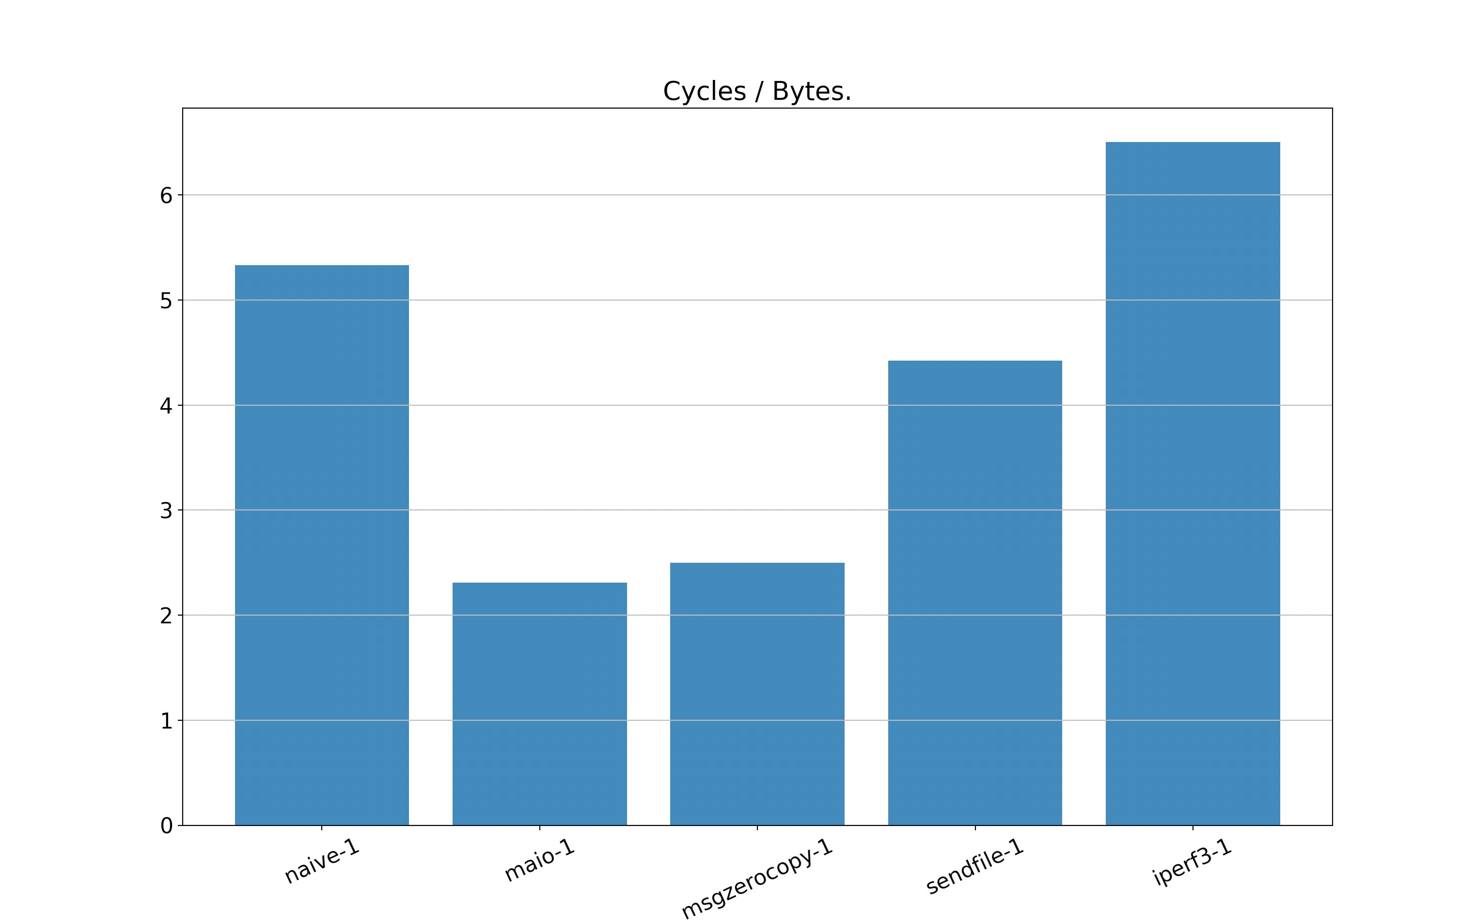
Comparing TX loop of 16KB buffers
1 Thread
6.50
16 Core VM on GCP
32Gb/s Egress
64 GB Memory
16K * 2K buffers with 1 Thread
Cycles/Byte – Lower is Better
5.33
4.42
+8%
2.49
2.31

Slide 12
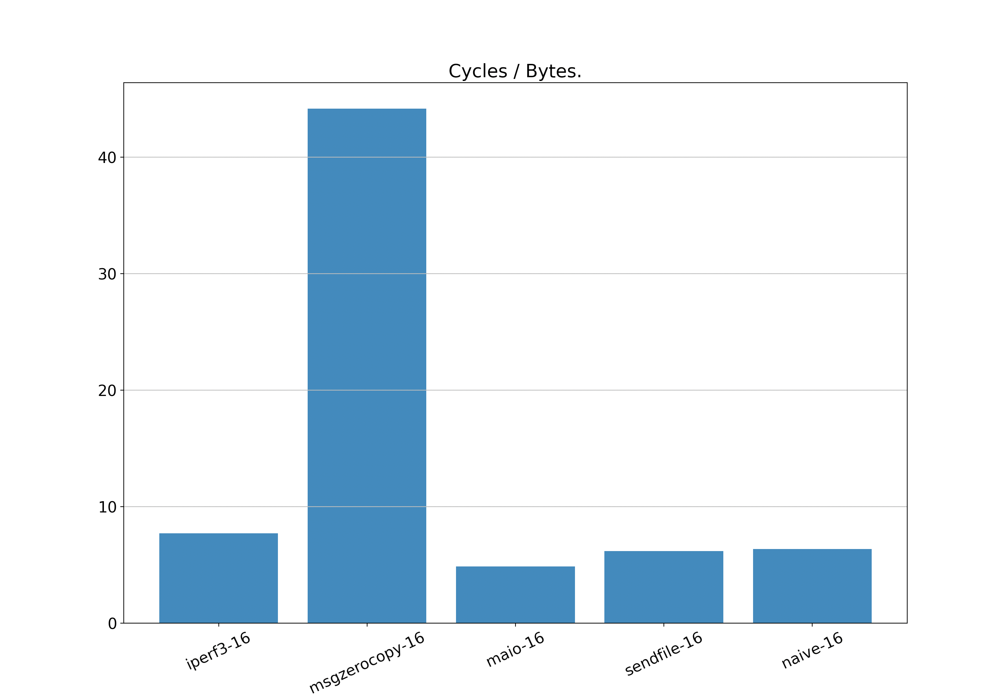
Comparing TX loop of 16KB buffers
16 Threads
44.2
16 Core VM on GCP
32Gb/s Egress
64 GB Memory
16K * 2K buffers over 16 Threads
Cycles/Byte – Lower is Better
7.73
+25%
6.18
6.37
4.88

Slide 13
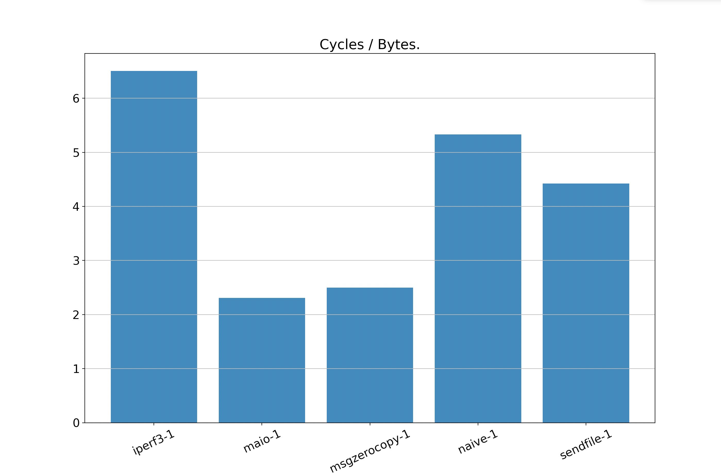
Comparing TX loop of 16KB buffers
1 Thread
6.50
5.33
16 Core VM on GCP
32Gb/s Egress
64 GB Memory
16K * 2K buffers with 1 Thread
Cycles/Byte – Lower is Better
4.42
2.31
+8%
2.49
Notes:
Setup info.
Naïve limited by BW and you often get weird hickups in performance.
better comparison is cycles/byte.
We measure the overall system cpu – idle ticks /proc/stat and the overall bytes sent.
+ introduce one by one
+ why only 8% send page vs send_msg
No sure can handle bigger buffers
Send_msg already has zero-copy which is incomnpatible.

Slide 14
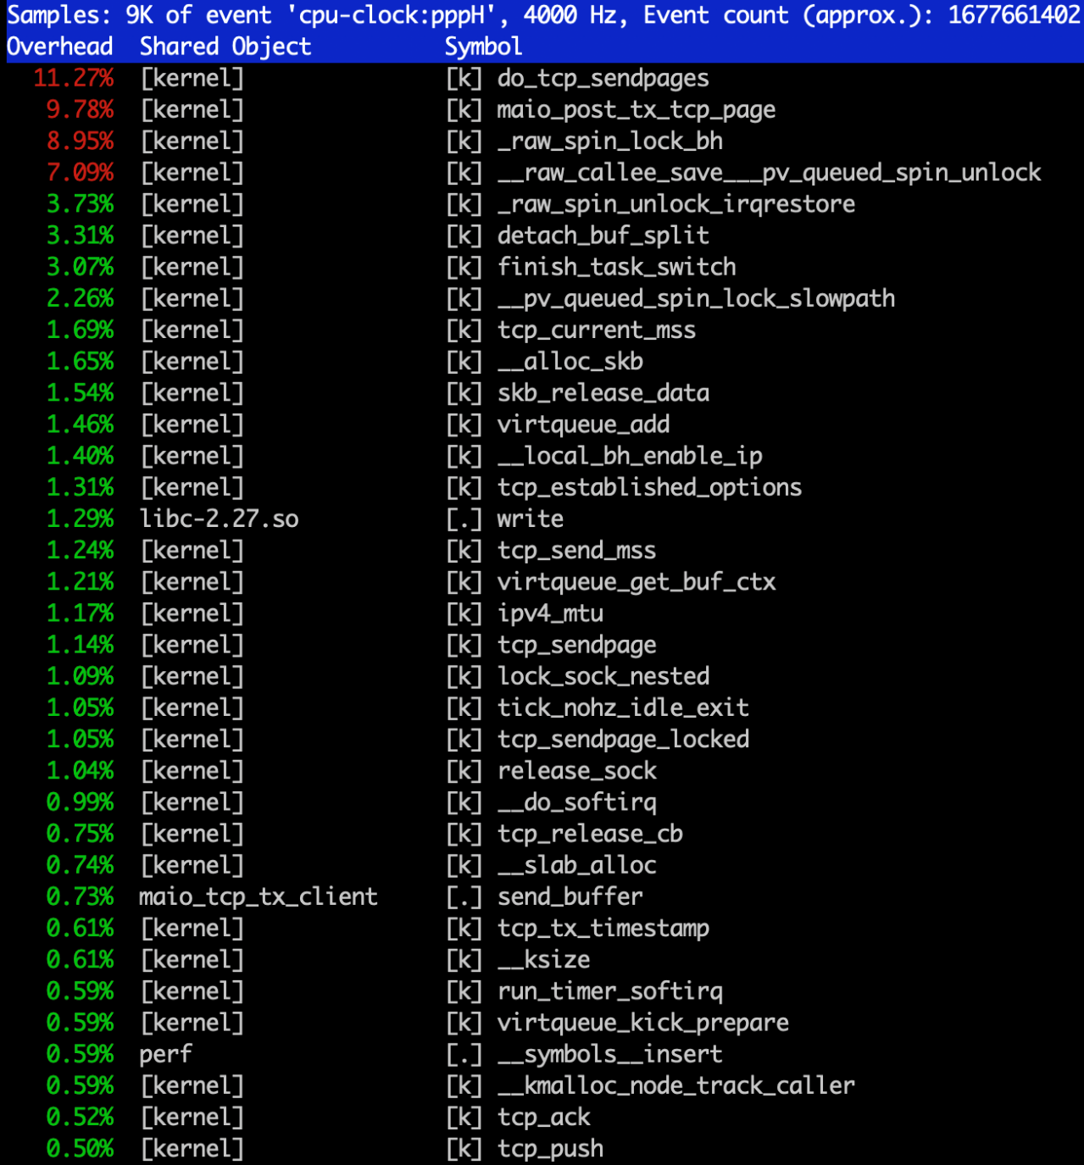
Comparing TX loop of 16KB buffers
1 Thread
16 Core VM on GCP
32Gb/s Egress
64 GB Memory
16K * 2K buffers with 1 Thread
Cycles/Byte – Lower is Better
MAIO Send
Notes:
We see here the perf breakdown – and indeed do_tcp_sendpages is the heaviest hitter.
Most of the work is on the async thread.
User barely does any work. – When Q is full it sleeps.

Slide 15
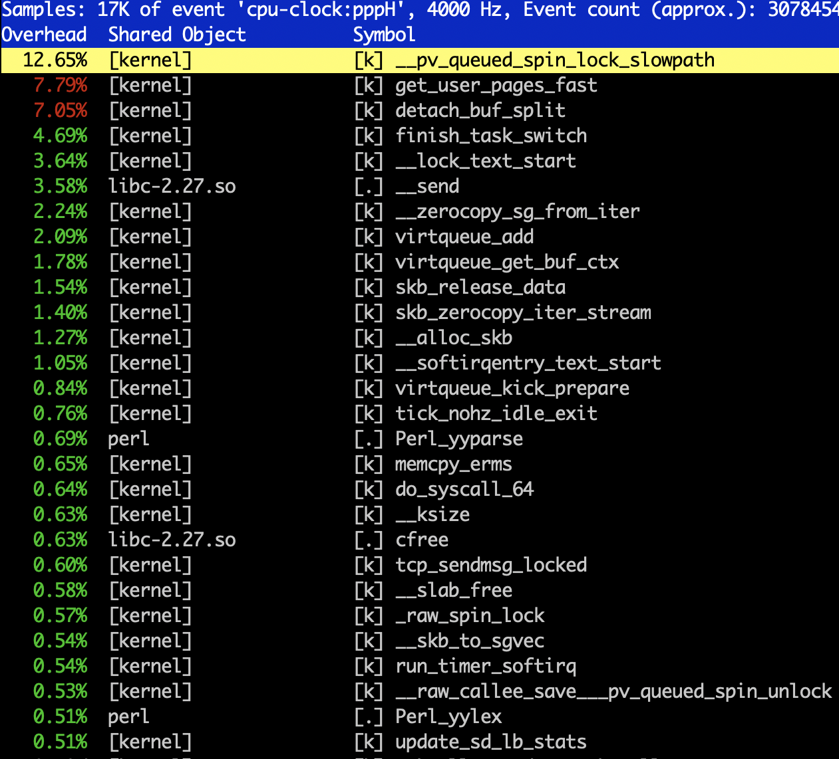
Comparing TX loop of 16KB buffers
1 Thread
16 Core VM on GCP
32Gb/s Egress
64 GB Memory
16K * 2K buffers with 1 Thread
Cycles/Byte – Lower is Better
MSG_ZEROCOPY

Slide 16
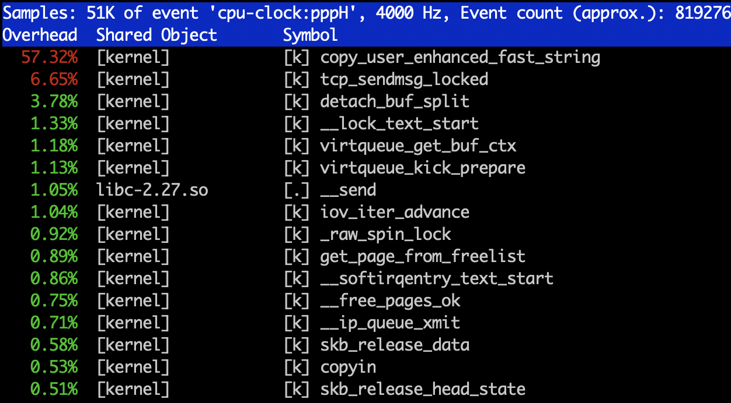
Comparing TX loop of 16KB buffers
1 Thread
16 Core VM on GCP
32Gb/s Egress
64 GB Memory
16K * 2K buffers with 1 Thread
Cycles/Byte – Lower is Better
Simple Socket
Notes:
Copy uses lots of copying. Could be worse if we did double of LLC.

Slide 17
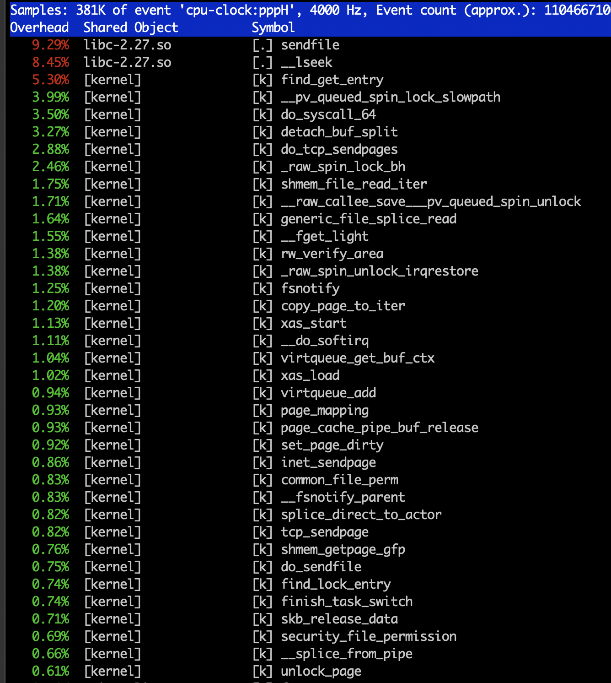
Comparing TX loop of 16KB buffers
1 Thread
16 Core VM on GCP
32Gb/s Egress
64 GB Memory
16K * 2K buffers with 1 Thread
Cycles/Byte – Lower is Better
Sendfile
Notes:
Copy uses lots of copying. Could be worse if we did double of LLC.

Slide 18
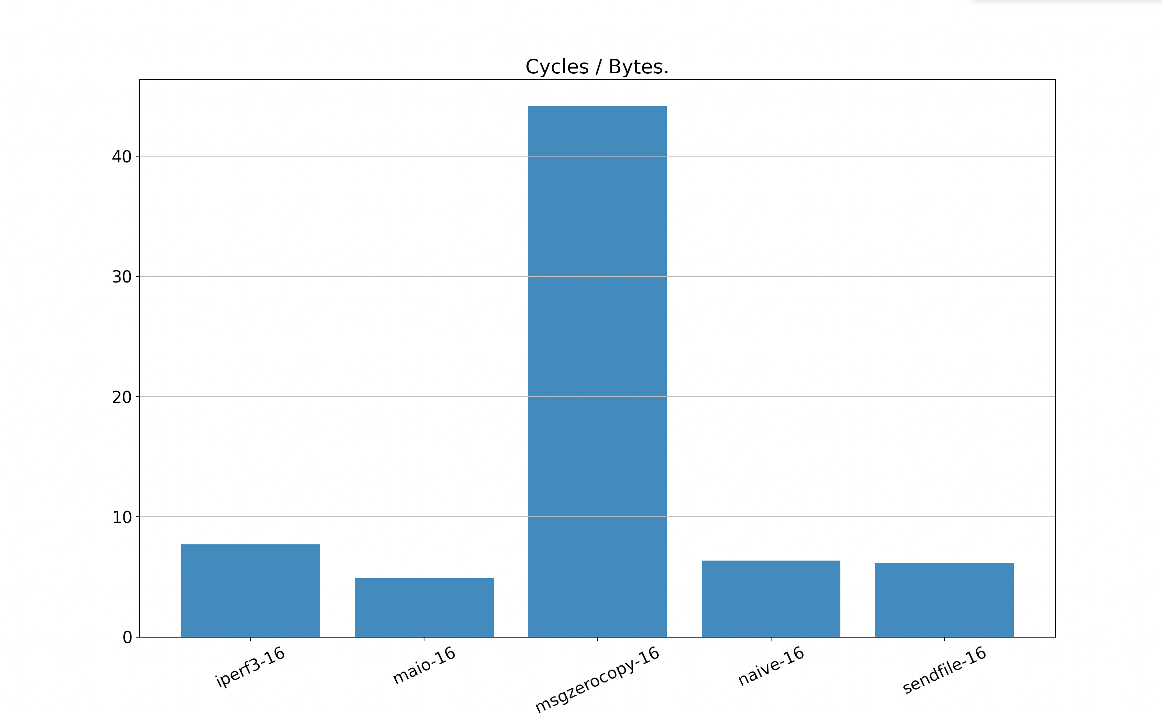
Comparing TX loop of 16KB buffers
16 Threads
44.2
16 Core VM on GCP
32Gb/s Egress
64 GB Memory
16K * 2K buffers with 16 Threads
Cycles/Byte – Lower is Better
7.73
6.37
+25%
6.18
4.88

Slide 19
Kernel Memory Segmentation
What is it?
  Memory Intended for a specific use case.
  Allocate with a dedicated allocator.
  Mange and Free with standard
  put/page operations.
include/linux/mm_types.h
struct page {} (64B metadata)
get/put_page()
compound_head()
page_ref_inc
Notes:
Kernel support memory segmentation.
In kernel
Dedicated allocator a cache
But free and ref counting are standard.
Need to get back to MAIO alloc.
Struct page -1. exactly 64B for each 4K. 2) HP 2MB are a contig array of 512 pages. Where the first is head rest are tail 3) can hide additional MD.
API you need is 1. get/put 2. compound head 3. page_ref_inc will cause bugs.

Slide 20
Kernel Memory Segmentation
What is it?
  Memory Intended for a specific use case.
  Allocate with dedicated allocator.
  Mange and Free with standard
  put/page operations.
    Example DEV_PAGEMAP
    static inline void put_page(struct page *page)
    {
    page = compound_head(page);
    if (put_devmap_managed_page(page))
    return;
    if (put_page_testzero(page))
    __put_page(page);
    }
Notes:
Actualy we already have one example DEV_PAGEMAP
In put page we have dedicated handling.
MAIO with HP is different because unions of tail page and devmap overlap. Mixing is aquestion.

Slide 21
HugePages and Kernel Memory Segmentation
MAIO uses 2MB HP (compound pages).
First TailPage holds uaddr for fast memory translation and is_maio_page
struct { /* Tail pages of compound page */
unsigned long compound_head; /* Bit zero is set */
/* First tail page only */
unsigned char compound_dtor;
unsigned char compound_order;
u16 elem_order; /* Plug a 2B Hole*/
atomic_t compound_mapcount;
unsigned int compound_nr; /* 1 << compound_order */
/* 4B Hole*/
unsigned long uaddr; /* Uaddr*/
};
Notes:
We use 2MB HP and compound.
In union for first tail page
We hide uaddr kernel cant use user address in I/O
Identifies maio page. 1.) API works on each page rather than on the head. 2) head is out of I/O 3) tail is usually rc=0
And elem order for potential – sub compounding.

Slide 22
HugePages and MAIO
void *cache = init_hp_memory(PAGE_CNT); /*Init MAIO pages */
Get PAGE_CNT of 2MB HP
Kernel: Create a Memory Translation Table.
8B entry * 1 HP (2MB)
Kernel: Set page[1]->uaddr
Init custom memory management. (linked list of 4K and 16K)
Head Page is not used for I/O as ref count never 0.
Tail Pages have RC = 0 while in user space.
get/put_page operate on Tail Page not the Head Page.

Slide 23
Socket Managment
int idx = create_connected_socket(dip, port); /* Create a TCP socket */
Kernel: Create a Kernel TCP socket.
Kernel: Connect to destination.
Returns internal identifier for the socket.
Notes:
Once we have memory segmentation. The rest is simple.
Kernel sockets

Slide 24
Async TX Ring
init_tcp_ring(idx, cache); /* init the Async TX ring */
Allocate and Init a ring for async TX. Uses cache.
Kernel: affiliate socket and async ring. Uses idx.
Kernel: Create a kernel thread
Notes:
Async TX ring is not a new concept but useful.
1. Alloc ring from shared mem using cache.
Create Kernel thread
Affiliate the kernel socket and kernel thread.

Slide 25
Zero-Copy TCP TX
send_buffer(idx, buffer, len, flags);
Post a MAIO buffer on the ring[idx]
Wake-Up the kernel Thread (unless flags have MORE set)
Async TX Thread
Poll the ring[idx]
Use MTT to get kernel address
Send the buffer with tcp_sendpage
Notes:
Post buffer and wake up thread.
1. Allow batching.

Slide 26
Page State TX
  Who owns a sent buffer?
    RC handles correct state. page_ref_inc on each TX.
  Options.
    Socket notification (sock_zerocopy_callback/ubuf_info)
    Opportunistic state management on Head Page
        Transition 0 – 1.
    Sys-call to query page_ref_cnt
get_page
Head Page – shadow map of 4KB pages.
  512 4K pages in 2MB
  8B for each 4K Page on Head Page
Notes:
The question of ownership, you can’t modify until kernel is done.
On each send the page rc is increased.
This is wrong + yes get page
Couple of options,
msg_zerocopy cb and ubuf in general
Oprtunistic management using head page on 1-0 transition. Have 8B per 4K page – subject to race. New TX with free.
Sys call to get Page RC.

Slide 27
Zero-Copy TCP RX
tcp_receive_sg(idx, io_vec, cache)
Collect a sg list from the TCP socket
kernel: Translate kernel address to user address using page->uaddr
Kernel: refill kernel pages
Kernel Modifications
RX:
skb_zerocopy_iter_stream modification skb_zerocopy_sg_from_iter (tcp_mmap)
Init:
A MAIO implemenmtation: MAIO allocator for RX ring
  Magazine allocator
Driver modification (AF_XDP)

Slide 28
Page State RX
  Who owns the received buffer?
    RC handles correct state.
  Options.
    Opportunistic state management on Head Page
    One RX per page (XDP)
        RX buffer ownership transferred on RX
  Who owns the mixed-use page?

Slide 29
DPDK MAIO-PMD
  Why?
  HW Agnostic
  Standard Linux Tools
  Hybrid use-case
      Decrypt in user-space and plain text via network stack
  How?
  RX ring
  Direct xmit (pktgen)
  Already HP and own memory mangment

Slide 30
Next Steps
Upstreaming
  Linux Kernel
  DPDK
  User Library
Dethrone SRIOV
  QEMU is just another process
  Nested MAIO support
Efficient Copy Semantics with Intel SIMD - SSE (?)
  Vector operations are fast
  6 memory channels

Slide 31
Github
Kernel & User Lib: git@github.com:Markuze/maio_rfc.git
DPDK: git@github.com:Markuze/maio_dpdk_rfc.git
Email : amarkuze@vmware.com

Slide 32
Authors
Place Photo
Here
Place Photo
Here
Place Photo
Here
Place Photo
Here
Place Photo
Here
Type Name Here
Type Name Here
Type Name Here
Type Name Here
Type Name Here
Place Photo
Here
Place Photo
Here
Type Name Here
Type Name Here

Slide 33
Development Status
Stable:
  Linux Kernel with MAIO support
  DPDK MAIO-PMD
WIP
  Integration into VeloCloud code
    HW Agnostic PMD - Single PMD to rule them all.
    No KNI

